Slide 1
Angular Training
Angular Form
Chee Guan, Ang
Angular Template-Driven Form and Reactive Form
October 6, 2020

Slide 2
Angular Form
INTRODUCTION
Handling user input with forms is the cornerstone of many common applications.
Applications use forms to enable users to log in, to update a profile, to enter sensitive information, and to perform many other data-entry tasks.
Angular provides two different approaches:
Template-driven Form
rely on directives in the template to create and manipulate the underlying object model.
Reactive Form
provide direct, explicit access to the underlying forms object model.
Compared to template-driven forms:-
they are more robust
they're more scalable
Reusable
testable.

Slide 3
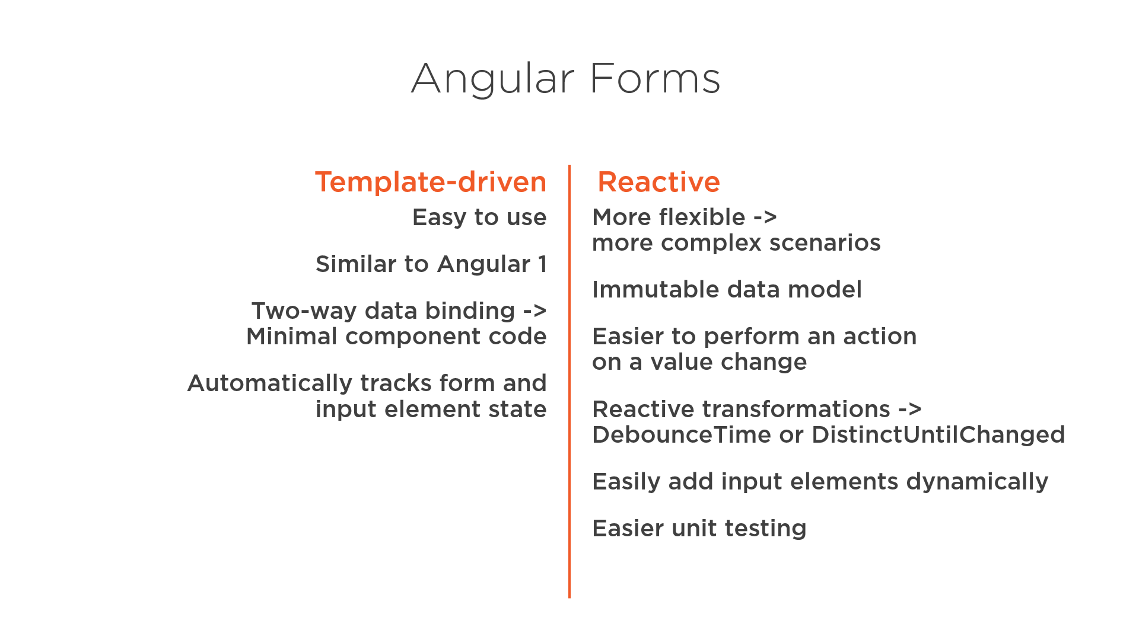
Angular Form

Slide 4
Angular Form
Template-Driven Form
FormModule
NgForm directive - does is create a top-level FormGroup and lets us call functions as if it was an instance of a FormGroup
NgModel directive and name attribute - creates the FormControl instance to manage the template form control and the name attribute tells the NgModel directive what key to store that FormControl under in the parent FormGroup
ngSubmit directive + a button
import {FormsModule} from '@angular/forms';
<form #f="ngForm"> ... </form>
<input name="email" [(ngModel)]="model.email" >
< <form (ngSubmit)="onSubmit()">
. . .
<button type="submit" class="btn btn-primary" >Submit</button>
</form>

Slide 5
Angular Form
Template-Driven Form
The [( )] syntax is a combination of the syntax for input property binding [] and output event binding ().
The long form of writing the above would be:
The [()] syntax is shorter and clearly shows we are implementing two-way data binding on this input control.
<input ... [(ngModel)]="email" >
<input ... [ngModel]="email" (ngModelChange)="email = $event" >

Slide 6
Angular Form
Template-Driven Form
Validation
Attributes, Directives and Validator
required
pattern
minlength
Custom Directive
The NgModel directive on a control tracks the state of that control.
<input type="password" class="form-control" name="password" [(ngModel)]="model.password" required minlength="8" pattern="[^ @]*@[^ @]*" >
<pre>Valid? {{f.form.controls.email?.valid}}</pre> <pre>Dirty? {{f.form.controls.email?.dirty}}</pre> <pre>Touched? {{f.form.controls.email?.touched}}</pre> <pre>Pristine? {{f.form.controls.email?.pristine}}</pre>

Slide 7
Angular Form
Template-Driven Form
The ? is called the elvis operator, it means
"Only try to call the property on the right of ? if the property on the left of ? is not null."
So if form.controls.email was null or undefined it would not try to call form.controls.email.valid (which would throw an error).
WHY? The controls can sometimes be null when Angular is building the page, so to be safe we use the elvis operator.
<pre>Valid? {{f.form.controls.email?.valid}}</pre>

Slide 8
DEMO

Slide 9
Angular Form
Reactive Form
ReactiveFormsModule
Fundamental building blocks
FormGroup - group of FormControl or FormArray
FormControl - class that is used to get and set values and validation of a form control
FormArray - array of FormControl, FormGroup or FormArray instances
import { ReactiveFormsModule, FormControl } from "@angular/forms";

Slide 10

Angular Form
Reactive Form
formControl directive to link the searchField FormControl to the template form control.
formControlName directive in the template to link individual template controls to controls on our FormGroup instance.
this.searchField = new FormControl();
<input type="search" [formControl]="searchField">

Slide 11
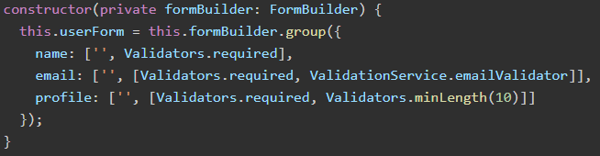
Angular Form
Reactive Form
formArrayName
Formbuilder – helper class to declare forms in component

Slide 12

Angular Form
Reactive Form
Angular Validators
required
email
pattern
maxLength
minLength
Custom Validator

Slide 13
DEMO

